Slide 1
CAAFI 2014
General Meeting
& Expo
Local Initiatives
Moderated by: Todd Campbell,
USDA, F2F2 Co-Lead
Produced by

Slide 2
CAAFI 2014
General Meeting
& Expo
Vicki Walker,
State Director of Rural Development – Oregon, USDA
Produced by

Slide 3
CAAFI 2014
General Meeting
& Expo
Tom Maloney,
Director, Technology, Research & Applications, CT Center for Adv. Tech.
Produced by

Slide 4
“Farm to Fly” Connecticut
Presentation to CAAFI General Meeting
Washington DC
January 28-29, 2014

Slide 5
Discussion Topics
Information about CCAT & State of Connecticut
USDA Rural Business Enterprise Grant (RBEG) Project in Connecticut
DLA Energy Alternative Fuels Program
Creating / Leveraging Opportunities via RBEG and DLA programs
Disclaimer: All of the facts and opinions expressed in this presentation are solely those of the Connecticut Center for Advanced Technology and are not endorsed or approved by the USDA, Defense Logistics Agency or other organizations listed in this presentation.

Slide 6
1. Information about CCAT
Not-for-profit economic development organization that combines expertise in cutting-edge technology with specialized centers of excellence in manufacturing, education, training, entrepreneurialism energy and alternative fuels.
Advanced Manufacturing and Energy Technologies in East Hartford, CT

Slide 7
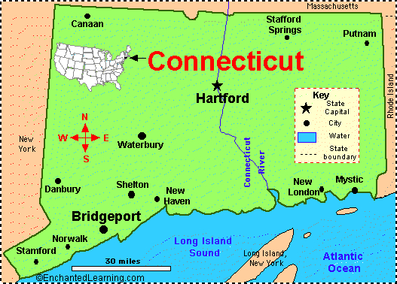
1. Information about State of CT
Demand for: - Jet Fuel, Diesel/Gasoline, - Home Heating Oil - Natural Gas (NG)
No Fossil Reserves - Some NG pipelines; - Pipeline expansion ongoing
Decent Solar Insolation
Limited Wind Resource
No Active Landfills
Nuclear Power
Significant Resources:
- Large, focused MSW supplies - “Environmental Culture”
Jet Fuel Pipeline

Slide 8
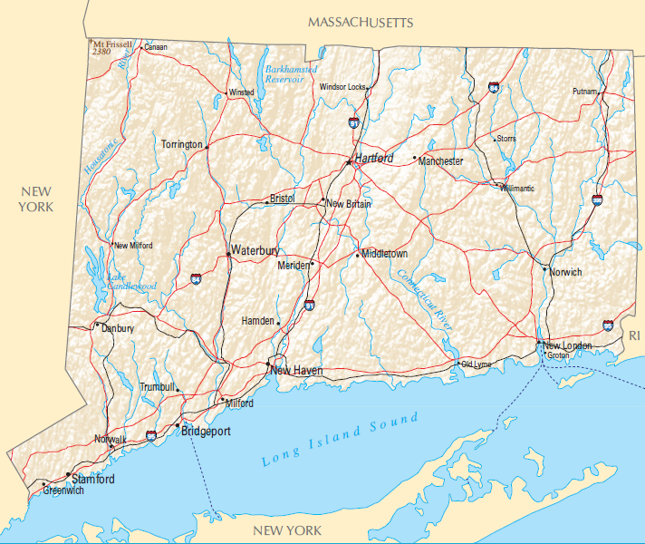
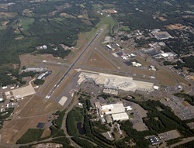
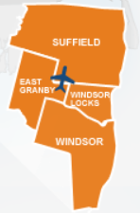
2. USDA Rural Business Enterprise Grant
The CT RBEG supports many beneficial activities that may boost the economy of the region, create jobs and could open the door for other ventures⁽¹⁾
In CT BDL, New England’s 2nd largest airport, is located in rural land and qualified for RBEG grant to develop jobs and economic opportunity in Rural Connecticut.
Bradley International Airport in Windsor Locks, CT
⁽¹⁾Please see www.rurdev.usda.gov/BCP_rbeg.html for detailed information

Slide 9
2. USDA Rural Business Enterprise Grant
Connecticut (CCAT) Project
Objective
Determine the feasibility of constructing a renewable fuel production facility in rural North Central Connecticut
Production of jet fuel, diesel fuel, and heating oil is of interest
Feedstocks: Municipal Solid Waste supplemented by biomass from farms, nurseries and other green waste streams
Benefits
If results are favorable, the proposed fuel production facility will boost the economy of the region, create jobs and could open the door for other ventures

Slide 10
2. USDA Rural Business Enterprise Grant
Project Team and Supporting Organizations
CCAT, CT Towns of East Granby, Granby, Suffield, Windsor Locks, Fiberight, Paine’s Inc., Solena Fuels, Altman Assocs., Bradley International Airport, Airlines for America, USDA Southern New England Jurisdiction⁽¹⁾
This team shares support for our national goals of environmental stewardship and energy independence. And this commitment also includes the implementation of programs and incentives to help American farmers produce feedstocks that can be converted into affordable and sustainable aviation biofuels
⁽¹⁾ C. Kimball is our USDA RBEG Project Manager, Amherst, MA

Slide 11
2. USDA Rural Business Enterprise Grant
Feedstocks
Municipal Solid Waste
Supplemental Biomass
Central CT waste collection greater than 800,000 tons/year
Supply of MSW – from over 70 towns; more towns possible (one of our RBEG project partners serves 26 CT towns)
Landfill no longer an option!
Forest thinnings
Wood and wood waste
Agricultural crops and residue
Nursery wastes

Slide 12
3. DLA Energy Alternative Fuels Program
CCAT and Arcadis U.S. are executing a project under leadership of DLA Energy to consider full range of gasification technologies for:
Diverse Feedstocks-to-Liquid Fuel – main focus
Diverse Feedstocks-to-Electricity
Test and evaluate technologies to advance commercial viability and comply with EISA 2007 Title V, Section 526
( L. Hicks and J. Maniwang are the DLA Energy project leads)

Slide 13
3. DLA Energy Alternative Fuels Program
Collaborative effort among DoD-DOE (NETL) and leverages existing U.S. capabilities
Existing Test Facilities
Technologies
Feedstocks Tested
EERC¹
NCCC²
Alter NRG³
Emery Energy⁴
Other TBD
Entrained Flow and Trnspt. Gasifiers
Transport Gasifier
Plasma Reactor
Reformer
Raw Biomass
Torrefied Biomass
MSW
Algae
Nuisance Plants
Used Railroad Ties
Coal
(Mixtures of the above)
Energy & Environmental Research Center, Grand Forks, ND
National Carbon Capture Center (DOE/Southern Co.), Wilsonville, AL
Westinghouse Plasma Corp., Madison, PA
Laramie, WY

Slide 14
4. Creating / Leveraging Opportunities
Connecticut Resources Recovery Authority (CRRA)
Strong interest in USDA RBEG Program and DLA Energy Program for exploring liquid fuels production from renewable domestic feedstocks
CRRA
Mission is to develop and implement environmentally sound solutions and best practices for solid waste disposal and recycling management
CRRA manages ~80 member towns’ solid waste through three CT trash-to-energy systems (Hartford, Bridgeport, Preston)

Slide 15
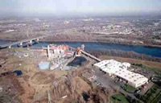
4. Creating / Leveraging Opportunities
CRRA Hartford Facility
REFUSE-DERIVED FUEL (RDF) TRASH-TO-ENERGY FACILITY
Trash collected from ~50 towns
Towns pay CRRA for MSW collection
MSW processed to RDF at Hartford facility
CRRA burns RDF to generate/sell electricity
May now consider MSW/RDF-to-Liquid Fuels
MSW collection and processing system already in place
Real estate available for additional equipment
Location in proximity to jet fuel pipeline
Hartford trash-to-energy plant

Slide 16
4. Creating / Leveraging Opportunities
USDA RBEG (commercial) and DLA Energy (military) projects are complementary and benefit the overall aviation supply chain
USDA RBEG connecting fuel suppliers with feedstock owners locally best way to identify and communicate opportunities rapidly
Multiple biofuel end customers (jet, diesel, home heating oil) optimizes efficiency – enhances commercial business opportunity
Immediate opportunity to determine feasibility of MSW/biomass to aviation fuel, diesel fuel, and home heating oil to serve north rural CT and western MA.

Slide 17
Acknowledgements
Connecticut Center for Advanced Technology, Inc. (CCAT):
A. Foysol, B. Karasik, T. Maloney, J. Rinebold, J. Smith,
W. Sumple, M. Wadden, A. Willhide
Arcadis U.S.: M. Barmasse, A. Danzig
Alternative Fuel Producer Contributors to RBEG:
Solena, Fiberight, CAAFI (R. Altman), Paine’s Inc.
USDA:
Programmatic and Technical Project Leadership: C. Kimball
DLA Energy:
Programmatic and Technical Project Leadership: L. Hicks, J. Maniwang
Disclaimer: All of the facts and opinions expressed in this presentation are solely those of the Connecticut Center for Advanced Technology and are not endorsed or approved by the USDA, Defense Logistics Agency or other organizations listed in this presentation.

Slide 18
THANK YOU !
Tom Maloney, tmaloney@ccat.us
“Farm to Fly” Connecticut
Presentation to CAAFI General Meeting
Washington DC
January 28-29, 2014

Slide 19
CAAFI 2014
General Meeting
& Expo
Anju Dahiya,
Project Director, General Systems Research
Produced by

Slide 20
COST EFFICIENT ALGAL BIOFUEL PRODUCTION IN VERMONT
Jan. 28 - 29, 2014
2014 CAAFI General Meeting - Washington, DC
Anju Dahiya
GSR SOLUTIONS LLC

Slide 21
COST EFFECTIVE ALGAE PRODUCTION IN
NORTHEAST / NEW-ENGLAND
ALGAE IN NORTHEAST / NEW ENGLAND
GSR SOLUTIONS VERMONT FOCUS/RESUME
VERMONT RBEG PROJECT
PROJECT COMPONENTS
SPECIFIC GOALS
PROCESS DESIGN APPROACH
BENCHMARKS FOR SUCCESS
ADDED BENEFITS OF PROJECT
A PATHWAY TO COMMERCIAL DEMONSTRATION/
DEVELOPMENT

Slide 22
ALGAE in Northeast NOT NEW?
From
a small 1950s MIT rooftop bioreactor
To
a two decades of ASP DoE NREL Algae Species program (1978-1996)
ASP Recommendation : Integrate with wastewater treatment to grow algae
cost effectively.
GreenFuel Corp MA USA CO2 mitigation & algoil raised over $19 million

Slide 23
Vermont “Bottoms-Up” Developments &
Targeting Algal Biofuel Technology Scale-Up
Led by GSR SOLUTIONS LLC (GSR)
Airlines (CAAFI) and Home Heating Oil Customer focus (VFDA)
Focus on Vermont Feedstocks
Dairy farm effluents & Cellulosic non-food crops/waste
Industrial Waste Streams
Projects supported:
USDA (RBEG)
Dept. of Energy,
VT Sustainable Jobs Fund NSF, VT EPSCoR

Slide 24
Vermont/GSR Resume
Bioprospecting/Isolation of microalgal & related organisms for
waste-grown biomass production for fuel
Algae culture collection facility hosting oleaginous
algal strains tested for waste treatment potential
Algal mass culturing for fuel utilizing auto-mixotrophic
and heterotrophic modes & related systems
Rapid screening methods for algal isolation, lipid and nutrients testing
Advanced technologies for algal biomass harvesting, its conversion to oil
and other valued byproducts
Fertilizer and animal feed production.
Data management and data analysis infrastructure to
inform larger scale systems.
PILOT /DEMONSTRATION FACILITY TO "SCALE UP" PROCESS IN RURAL COUNTY

Slide 25
Farm to Fly 2.0: USDA RBEG supported project
PROJECT COMPONENTS
Oil-rich indigenously isolated algal strains
& related microbes
Scalable algal biomass production systems –
Integrate with local waste-based throughput feedstocks

Slide 26
Nordic Farm: 300 milking cows
Farm puts around 200 tons of urea as fertilizer per acre only for grass grown
Picture source: Nordicfarms.com
Farm spent $75000 in fuel costs & invested $500,000 in the digester
Farm is located on the truck route and other businesses including local beer brewery

Slide 27
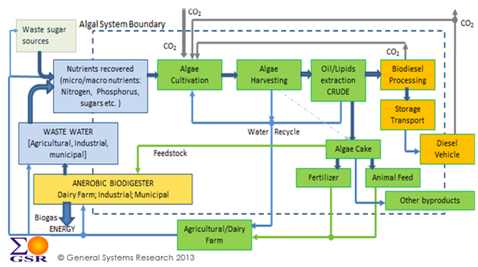
GSR System Process Model for Integration of Algal Biomass Production for Oil with Waste Treatment
© GeneralSystems: Res:ea rch 2013

Slide 28
VERMONT RBEG
- BENCHMARK FOR SUCCESS
Process candidate identified with positive energy return on investment at market rate
Cost of biofuel per gallon competitive with oil
Fuel standard including the Sulfur content:
projected to meet EPA RFS 2 standards as an advanced biofuel
Sustainable & Scalable:
continuous supply of throughput feedstocks,
acceptable business case;
nutrients recovery from the wastewater to meet with the state/EPA regulations;
none or positive land use change at the farm.

Slide 29
Benefits of ongoing VT RBEG project
Integrating the supply chain
with the suppliers of throughput feedstock sources for algae
production (farm, brewery, other potential suppliers ), and
with technology end users:
Fuel & Fertilizer – Farms, and other businesses in the area (greenhouses, vegetable growers etc.)
Jet Fuel - CAAFI & Burlington-based aerospace industry
Home heating oil – VT Fuel dealers Association
Adding valued by-product – fertilizer
the farm runoff nutrients captured by algae to produce granular fertilizer and rerouted to farm for enriching soils for crop production.
Harmonizing With State Environmental/Economic goals
next step – demonstration in rural county

Slide 30
Acknowledgements
USDA
We are grateful to our funders, partners & supporters
.:.-
:.a..
O
Un ted St t D partment of Agraculture
Ru ID v lopm nt
.
I
U.S . DEPARTMENT OF
ENERGY
-·-·--
n
WHERE DISCOVERIES
undati n
BEGIN
VERMONT
NASA EPSCoR
EPA
----­ VFDA
CAAFI
John Todd Ecological Design
Vcrmcmt F'ud Dt.J/crs .As;.ociation
'
'
We are inviting partnerships and investment from private sector

Slide 31
Thank You
Anju Dahiya, Ph.D.
President,
GSR SOLUTIONS LLC
adahiya@GenSysResearch.com
www.GenSysResearch.com
Note: White paper for follow up plan available

Slide 32
CAAFI 2014
General Meeting
& Expo
Chris Cassidy,
Renewable Energy Advisor, USDA
Produced by

Slide 33
CAAFI General Meeting
January 29, 2014
Washington DC
Notes:
Title Slide

Slide 34
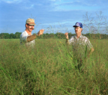
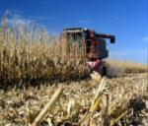
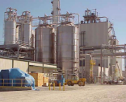
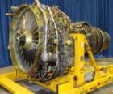
Alternative Jet Fuels Supply Chain – Agency Effort Summary
Conversion Process Scale-up/Integration
Fuel Testing/Approval
Feedstock Production
Feedstock Logistics
Fuel Conversion
Fuel Performance
Environment Assmt
Enable Production
End User/ Buyer
USDA |  |  |  |  | --- | --- |  | ---
DOC | ✓ | --- | ✓ | ✓ |  |  | ---
DOE |  |  |  |  | --- |  |  | ---
DOD | --- | --- | --- | --- |  |  | ---
EPA | --- | --- | --- | --- | --- |  |  | ---
FAA | --- |  | --- |  |  |  | ---
NASA | --- | --- | --- | --- |  |  | --- | ---
NSF |  |  |  | --- | --- | --- | --- | ---
34
Notes:
34
Overview of the supply chain and the areas in which agency programs are supporting development of “drop in” jet biofuels.
Provides an across government perspective/presentation of the information of who and how each agency is providing support
Supply chain columns:
Feedstock production –- identification, assessment and improvement of potential jet fuel feedstock crops
Feedstock logistics— support for harvesting/movement of the feedstock to where it needs to be
Fuel Conversion—R&D to develop and optimize alternative jet fuel conversion processes
Conv. Process and scale up – out of lab and pushing towards commercialization—prove scaled production
Fuel performance—how engine/a/c perfomr using the fuel → key to qualification and certification
Env. Assessment—air quality improvements & GHG LCA
Enable Production—govt. incentives to support a new industry such as USDA and DOE loan guarantee and grant program, RFS2, DOC investor education/webinars
End user—Agencies that use fuels (DoD), and in case of airlines (close coordination with fAA)
Sustainability analyses are being developed across the supply chain.

Slide 35
USDA Areas of Focus in Alternative Fuels - Summary
Feedstock Production
Feedstock Logistics
Fuel Conversion
Conversion Process Scale-up/Integration
Fuel Testing/Approval
Enable Production
End User/ Buyer
Fuel Performance
Environment Assmt
USDA |  |  |  |  | --- | --- |  | ---
High level description of agency effort:
Develop sustainable feedstock production systems and reduce supply chain transaction costs
Assess environmental and social impacts of biofuel deployment
Help enable commercial feedstock and biofuel production
35
Notes:
35
Provide your agency areas of focus across the supply chain and a high level description.
Indicate relative level of effort or direct involvement by color of checkmark (e.g. grey=less; black=greater)

Slide 36
Path to Commercialization - Overview
Approach/Strategy
Partners
Other Agencies Involved
Initiatives
R&D
Deployment
Pilot + Demonstration
First-of-a-Kind Commercial Scale
Commercial replication
(Federal) USDA, DOE, DOT, FAA, DOD, DOC, DOI, EPA, State
State Departments: Ag Energy, Ecology
Stakeholders: Farmers, Ranchers, Foresters, Fishers, Businesses
Labs: National, State, Private
Industry: Academia, Associations (CAAFI, A4A)
Rural Development (RBS & RUS)
NRCS
FSA
NIFA
ARS
FAS
Farm Bill 2002, 2007 and 2014
EISA
RFS & Modifications
Copenhagen
Farm to Fly 1 & 2.0
BioPreferred Program
Feedstock
Oilseeds, perennial grasses, algae biomass, wood lots & plantations, agriculture waste & residue, forest waste & residue, municipal solid waste
Conversion Technologies
Biological,
Bio Fuels & Bio Products
Jet A, Jet A1, JP5, JP8, F76 + lubricants, bio products
Certifications
ASTM, Military, Euro/International Industry standard
RD Programs
RBOG, RBEG, VAPG, SSDPG, RCDG, RCDI, REDLG, B&I
FB 9000 Series: 9008, 9006, 9011, 9004, 9003, 9007, 9005
Manufacturing
Sustainability
Social, Environmental, Economic
Leveraging
Private
Federal
State/Local
Co-generation
Co-products
Bioeconomy Expansion
Bio-Chemical,
Thermo-Chemical
Hybrid
Farm to Fleet
Bio Economy

Slide 37
Path to Commercialization with Example Partners + Funding Sources
R&D
Deployment
Pilot + Demonstration
First-of-a-kind Commercial Scale Up:
Commercial Replication
DOE, USDA (ARS, NIFA), DOT, Academia, private partners
Section 9003 Biorefinery Guarantee, Lenders, Venture Capital, Mezzanine, Angel, etc.
USDA B&I and REAP guarantee
Private Investment
Commercial Lenders
Technical Assistance, Regional Planning
DOE grant, RBEG, RBOG, Cooperative Development
9008, NARA, AHB
ARS Regional Centers, DOE, DOT, DOD, Industry, Academia
ZeaChem positioned to move into Commercial Scale-Up phase

Slide 38
Path to Commercialization – Critical Role of Loan Guarantees in Advanced Biofuels to Market
First-of-a-kind Commercial Scale Biorefinery
Technology Phase: R&D, Deployment, Pilot , Demonstration
Driving Initiatives: Farm Bill, BioPreferred, EISA, RFS 1 +2, Copenhagen, MOU
Development: Feedstock + Conversion Technology Platforms
Funding Partners: Federal, State, Industry, Academia, VC, Private
Certifications: ASTM, Military, European/International Standards
ZeaChem Private Investment (~$200MM)
B&I and/or REAP/9007 Guarantee – Commercial Scale Replication
AHB $40MM, NARA $40MM, DOE $20MM, FAA $40MM over 10 years
Commercial Technology Replication
Manufacturing + Jobs
Bioeconomy Expansion
Sustainability: Social, Economic, Environmental
Commercial Lenders
9003 Guarantee ($198MM) – Commercial Scale-Up

Slide 39
Take Off Recommendation
USDA Summit to include:
ARS Regional Centers
FAA
NIFA Advanced Hardwood Biofuels (AHB) + NW Advanced Renewable Alliance (NARA)
FAA Center of Excellence
DOT, VOLPE
CAAFI
A4A (Airlines for America)
Academia
National Labs
Industry Partners (Boeing, GE, etc.)
DOE Tribal Program
1890 Institutions

Slide 40
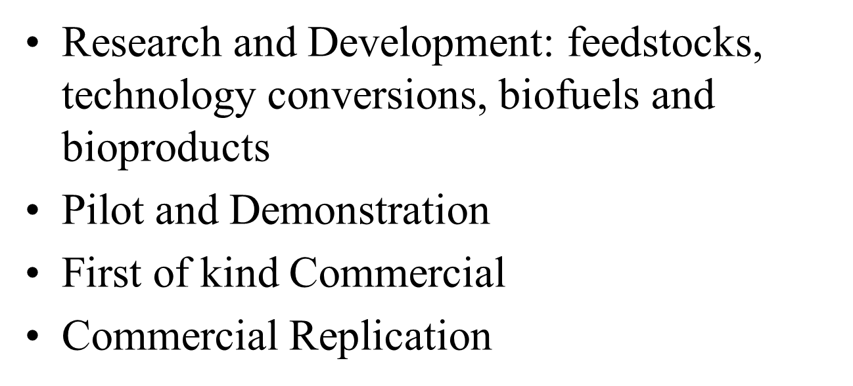
Notes:
Title Slide

Slide 41
Energy Investment Map
http://www.usda.gov/energy/maps/maps/Investment.html
Energy Matrix
Renewable Energy Tool
Notes:
Title Slide

Slide 42
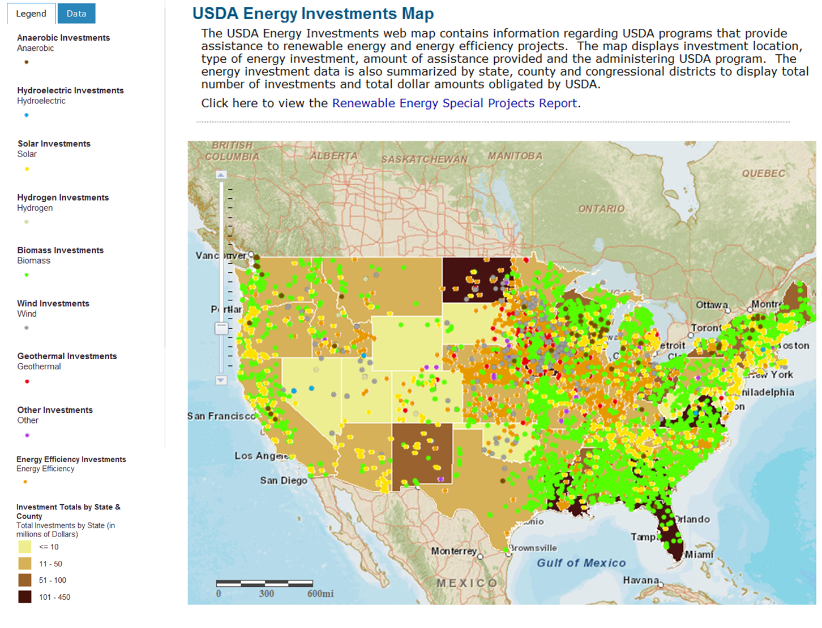

Slide 43
Requirements
Feasibility study
Technical report
Business plan
Environmental report
Agreements
Notes:
Title Slide

Slide 44
Programs
Rural Business Enterprise Grant
Rural Business Opportunity Grant
Cooperative Development Grant & Technical Assistance
Business & Industry Loan Guarantee
Notes:
Title Slide

Slide 45
Farm Bill 2014
Clear Priorities
Energy, Nutrition, Jobs
Targeted investments
Notes:
Title Slide

Slide 46
Farm Bill 2014
Rural Energy for America Program REAP
Feasibility Studies
Renewable Development Assistance
Renewable Energy Systems
Notes:
Title Slide

Slide 47
Farm Bill 2014
Biomass Research & Development Initiative
Biomass Crop Assistance Program
Value Added Producer Grant Program
Biorefinery Assistance Program
Bioenergy Program for Advanced Biofuels
Notes:
Title Slide

Slide 49
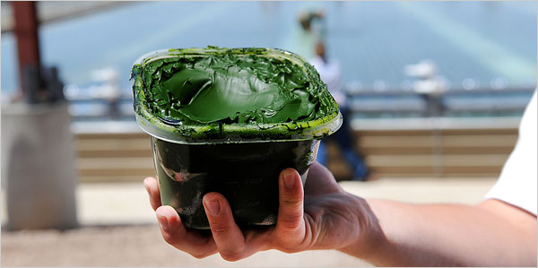
Algae

Slide 50
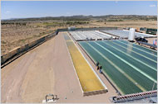
Algae

Slide 51
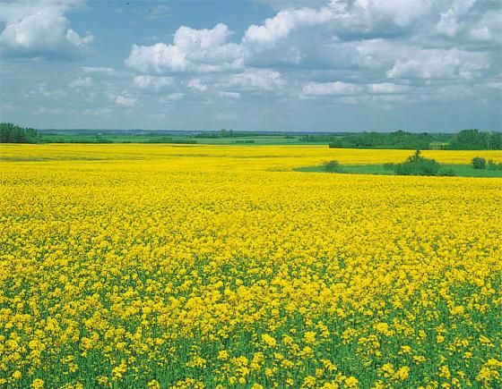
Feedstock Diversification

Slide 52
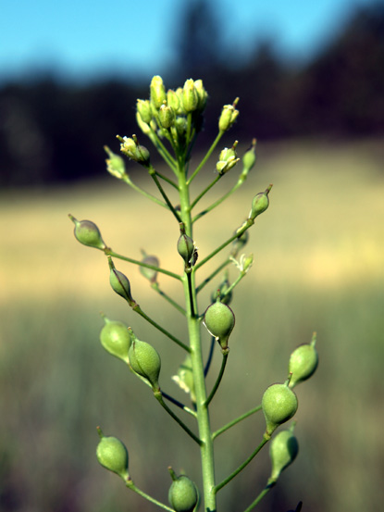
Feedstock Diversification

Slide 53
Feedstock Diversification

Slide 54
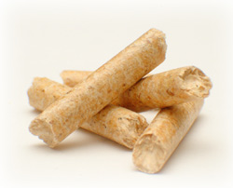
Feedstock Densification

Slide 55
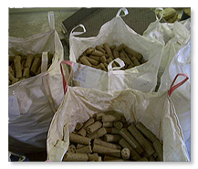

Slide 56
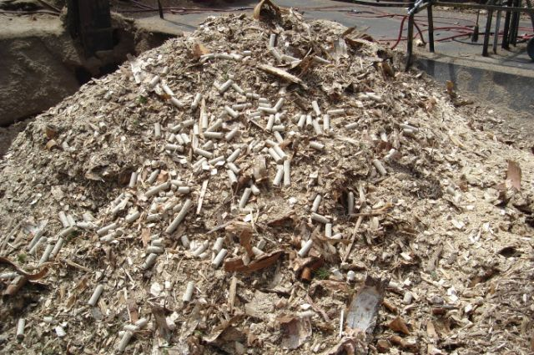

Slide 57
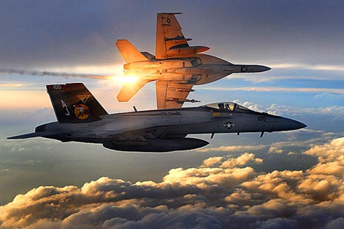
Advanced Aviation Biofuels

Slide 58
Advanced Aviation Biofuels

Slide 59
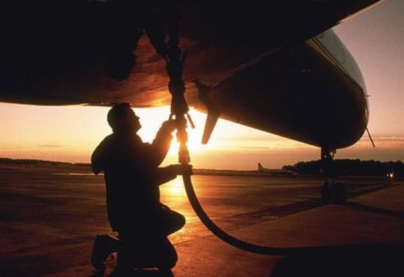
Advanced Aviation Biofuels

Slide 60
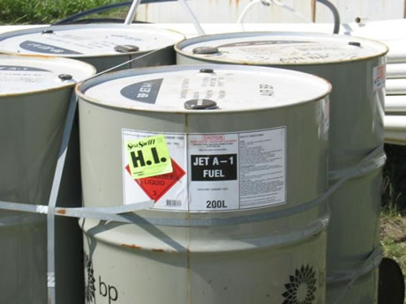

Slide 61
Thank You
Chris.Cassidy@wdc.usda.gov
202 841 6097

Slide 62
CAAFI 2014
General Meeting
& Expo
Rich Altman,
Executive Director Emeritus, CAAFI
Produced by

Slide 63
“Farm to Fly” State/Local Initiatives Success Model Lessons …. Building Future Projects
CAAFI Biannual General Meeting
January 29, 2014
Washington, D.C.
Rich Altman, Executive Director Emeritus
Commercial Aviation Alternative Fuels Initiative (CAAFI)

Slide 64
“Farm to Fly” State/Local Progression
Key Lessons from initial “Farm to Fly” Initiatives (Vermont, Connecticut, Oregon)
South Carolina – RBEG Proposals…case study for new initiative formation
Key take away….. “Farm to Fly” can work in your state / province … success formula available and effective.

Slide 65
“Farm to Fly” Key Lessons from States
All projects are local/unique
“Experience Templates” applicable to new projects
Focus on full supply chain…start build up from feedstocks… incorporate customer stakeholders
Strong Local private leadership with supply chain knowledge/access essential
Lead fuel company engagement /exposure with “limited bandwidth” major goal/benefit
Rural Development “Tool Kit” enables progression
USDA State Director / CAAFI lead consult is first step
Relationship Build is Top Outcome!

Slide 66
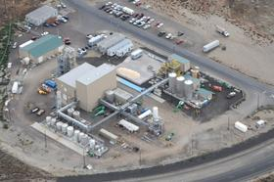
All Projects are Unique / Local
Vermont…High Sugar content waste streams feed “Dark Algae” fed fuel… granular Fertilizer co-product.
Connecticut … Building a global future for BDL, viable MSW to Energy in Northeast Corridor
Oregon…. SAFN focus contributed to Zeachem Boardman Initiative

Slide 67
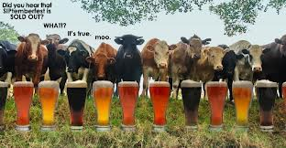
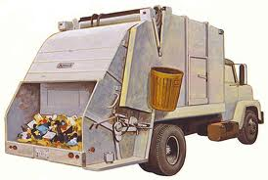
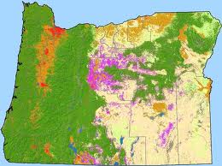
Feedstock Focused Supply chain
Vermont…Dairy and Beer Brewery Waste streams enable dark algae growth
Connecticut … MSW base strong and centralized public / private capture
Oregon…. Creative Woody Biomass productivity and capture

Slide 68
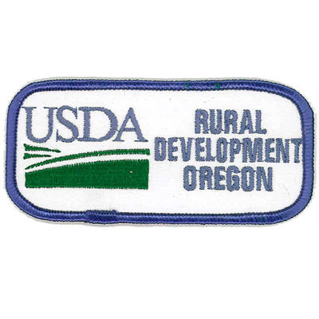
Strong Local Team Leadership

Slide 69
South Carolina “Farm to Fly” Next
Building from Well Defined Feedstock base
Strong Local private supply chain
Diverse (mil./comm.) customers engaged
Early Engagement with USDA S.C. Office
Strong State and Local Community Participation
RBEG Experience Template (from CT)
Path for lead Fuel company engagement addressing requirement/ benefits set

Slide 70
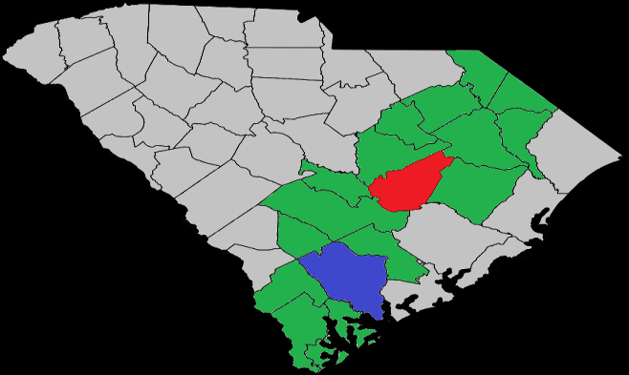
South Carolina – New Initiatives
Strong Feedstock Potential (ref. USDA/SCRA 2012 report) e.g. Algae, Woody Biomass
Diverse aviation fuel proven process potential: FT, HEFA, Thermochemical, Alcohol to Jet
Real CAAFI customer / fuel stakeholder interest
I-95 Corridor has need /Assets
RBEG Proposals
- Clarendon (Woody)
- Colleton (Algae)

Slide 71
Strong SC Team Leading, Supporting
Feedstock Centric Private Leadership
Public Advocacy and Support

Slide 72
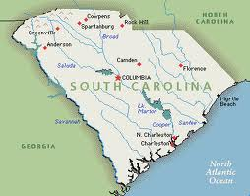
SC Aviation Demand Strong 200M+ usg with Growth and Supply Security Needs
Beaufort – Navy/Marine Air
Charleston - Commercial Air / Boeing
Charleston - C17 Maintenance
Columbia – Air National Guard
Charlotte - U.S Airways Hub
Savannah - Gulfsteam production
Cherry Point - Navy/Marine Air
Charleston – Commercial Marine
Package Freight – Air / Ground

Slide 73
SC RBEG Goals / Pathways Set
SCRA report... USDA/DOC EDA I-95 corridor study
- “Sustainable biomass energy crops …projected $25 - $30 ton”…. Woody biomass for starters
- “resources to be a prominent player in algae production
CAAFI / Navy Markets Identified 2011 - 2013
- ACI focused CAAFI began with Charleston growth
- Navy identified base needs
CAAFI/Navy/ Biomass Council /USDA set plan 9/13
SCCEBA selected leads submitting proposal 2/14
- county engagement set
- two fuel companies each proposal
- company benefits /requirements identified

Slide 74
Farm to Fly in your State / Province?
Consult with the “Farm to Fly 2.0” Team
CAAFI : Steve Csonka (Csonka.caafi.ed@gmail.com)
Rich Altman (rcbaltman@gmail.com)
www.caafi.org
USDA: Chris Cassidy (chris.Cassidy@wdc.usda.gov)
Vicki Walker (Vicki.walker@or.usda.gov)
Tony Logan (tony.logan@oh.usda.gov)
Todd.Campbell (todd.Campbell@osec.usda,gov)
Put F2F2 Model To Work for You!

